Slide 1
Fundamental Economic Concepts

Slide 2
Introduction
Economics:
A science that deals with the allocation, or use of scarce resources for the purpose of fulfilling society’s needs and wants.
The study of how limited resources is used to satisfy unlimited human wants.
The study of how people choose to use the available resources.

Slide 3
Resources include:
the time and talent of the people available,
the land, buildings, equipment, and other tools on hand,
Money.
Important choices involve:
how much capital to spend and how much to save?
how to combine resources to produce good quality goods and services?

Slide 4
Engineering Economics:
The science that deals with techniques of analysis useful for selecting a preferable alternative from several technically viable ones.
Engineers seek solutions to problems, along with the technical aspects the economic viability of each potential solution is normally considered.
Fundamentally, Engineering economics involves formulating, estimating, and evaluating the economic outcomes, when alternatives to accomplish a defined purpose are available.

Slide 5
Why Engineering Economics?
Decision Making:
Decision??
Making a choice from two or more alternatives.
The Decision-Making Process
Understand the Problem
Collect all relevant data/information
Allocate weights to the criteria
Define the feasible alternatives
Analyze and Evaluate each alternative
Select the “best” alternative
Implement and monitor

Slide 6
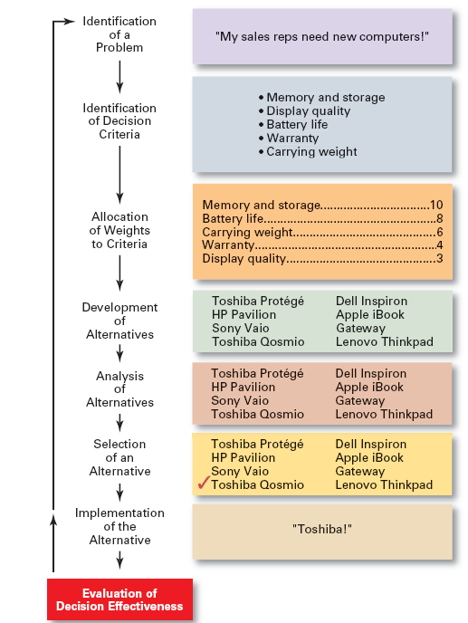
The Decision-Making Process

Slide 7


Micro & Macro Economics:
Micro Economics
Micro economics focusses on how decisions are made by individuals and firms and the cause of those decisions.
Helps in studying what is going on within the firm.
This focusses on specific companies in specific industry sectors.
Micro economic concepts are simple & easy to understand.
Macro economics examines the aggregate behaviour of the economy.
This studies the behaviour of economy as a whole not just on specific industries.
Measuring inflation or unemployment comes under macroeconomics.
These concepts are not simple & direct.
Macro Economics

Slide 8

Concept of Value and Utility
Value
“Value designates the worth that a person attaches to an object or services”.
The value of an object is not inherent in the object but is inherent in the regard that a person or people have for it.
There may be no relation of value to cost of the product/object.
Utility
Utility is the power to satify the human wants.
Even for same consumer, utility varies from unit to unit, time to time and from place to place.
The utility that an object has for a person is the satisfaction he derives from it.

Slide 9
Types of Utility
Form Utility: The physical/chemical changes that makes the object more valuable.
E.g. Wood when converted into Furniture.
Place Utility: The product is made readily available/accessible to potential customers.
Time Utility: The product is made available to customers when they really want it or by storing a commodity and selling it at a time of scarcity, utility can be realized more.
Umbrellas during/just before rainy season.
Possession Utility: When a customer really buys the product/ownership title is transferred to the buyer.

Slide 10
The factors of production include: Land Labor Capital Entrepreneurship

Slide 11
Factors of Production
An Economic term to describe the inputs that are used in the production of goods and services in an attempt to make an economic profit.
1. Land
All gifts of nature, such as: water, air, minerals, sunshine, plant and tree growth, as well as the land itself which is applied to the production process.
2. Labor
The efforts, skills, and knowledge of people which are applied to the production process.
3. Capital
Real Capital - Tools, buildings, machinery -- things which have been produced which are used in further production.
Human Capital - Education and training applied to labor in the production process.

Slide 12
4. Entrepreneurship

Slide 13
Types of Goods:
Consumer Goods
It also satisfy human wants but indirectly, as a part of the production and construction process.
They are the means to produce the consumer goods, usually by facilitating the alteration of the physical environment.
The demand for these goods is derived from the consumer goods.
Machine tools, transport services, material handling equipments etc.
Goods / Services that directly satisfy human wants by consumption, owning or possessing, by the service that he gets.
Eg.: TV sets, Refrigerators, Books, Shoes, food items, Health services etc.
Producer Goods

Slide 14
Demand Analysis
Few important concepts
Purchasing power
Substitution effect
Income effect
Giffen goods

Slide 15
Demand Analysis
Demand: Demand for a commodity refers to the quantity of the commodity which an individual customer or household is willing to purchase per unit of time at a particular price.
Demand for a commodity implies the following:
Desire of a consumer to buy a product.
Sufficient purchasing power.

Slide 16
Demand Analysis
Types of demand :
Individual Demand: When we are dealing with goods demanded by an individual, it is called as individual demand.
Household Demand: If the goods are demanded by the household, then it is said to be household demand.
Individual
Demand
Household
Demand
Market/ Aggregate
Demand

Slide 17
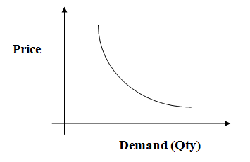
Law of demand:
Demand Curve

Slide 18
The law of demand says “ Demand for an item increases with a fall in price and diminishes with rise in price, while other determinants are held constant”.

Slide 19
Factors Influencing Demand:
The shape of the demand curve is influenced by the following factors:
Income of the people
Price of item or product
Tastes and Preferences of customers.
Expectations

Slide 20
Exceptions to the Law of Demand
Commodities which are used as status symbol.
Ex – Ornaments, Luxury Cars
Expectations of change in the price of the commodity in the future.
Giffen goods: A giffen good occurs when a rise in price causes higher demand because the income effect outweighs the substitution effect. Suppose you have a very low income and eat two basic food stuffs rice and meat. Meat is a luxury and is much more expensive than rice.

Slide 21
In economics and particularly in consumer choice theory, the substitution effect is one component of the effect of a change in the price of a good upon the amount of that good demanded by a consumer
The income effect in economics can be defined as the change in consumption resulting from a change in real income. This income change can come from one of two sources: from external sources, or from income being freed up (or soaked up) by a decrease (or increase) in the price of a good that money is being spent on. The effect of the former type of change in available income is depicted by the income-consumption curve discussed in the remainder of this article, while the effect of the freeing-up of existing income by a price drop is discussed along with its companion effect, the substitution effect, in the article on the latter.

Slide 22
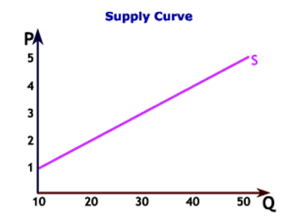
Law of Supply:
Supply is derived from a suppliers desire to maximize profits.
Where:
P- PRICE
Q-QUANTITIYSUPPLIED

Slide 23
Law of supply states that “All other factors being equal, as the price of a good/service increases, the quantity of a good or service that suppliers offer will increase, and vice versa”

Slide 24
Factors Influencing Supply:
The shape of the supply curve is influenced by the following factors:
Costs of the inputs
Technology
Weather

Slide 25
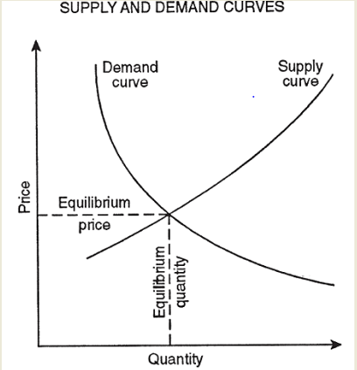
Equilibrium of Demand and Supply
Equilibrium Point
Ep
Eq

Slide 26
Self study Topics:
Concept of elasticity
Elasticity of Demand and supply
Equilibrium of Demand and Supply

Slide 27
Engineering Economics Subject Books
Text Books:
Engineering Economics – Riggs
Engineering Economic analysis – Newnan
Engineering Economy – Leyland
Reference Books:
Engineering Economy – Naidu
Management – Stephen P. Robbins and Mary Coulter

